Slide 1

JavaScript and jQuery Course
Session 12

Slide 2
Topics Covered
Selectors / Filters
Methods
Event Methods
Dom Manipulation Methods – not in text (extra)

Slide 3
Some of the most useful jQuery Selectors
also known as filters

Slide 4
Selectors / Filters
Same as CSS
:first-child | $("p:first-child") | All <p> elements that are the first child of their parent
:last-child | $("p:last-child") | All <p> elements that are the last child element
:nth-child(n) | $("p:nth-child(2)") | All <p> elements that are the 2nd child element
:first-of-type | $("li:first-of-type") | All <li> elements that are the first <li> element of their parent
:last-of-type | $("li:last-of-type") | All <li> elements that are the last <li> element
:nth-of-type(n) | $("li:nth-of-type(2)") | All <li> elements that are the 2nd <li> element
:only-child | $("p:only-child") | All <p> elements that are the only child of their parent
:only-of-type | $("p:only-of-type") | All <p> elements that are the only child of its type

Slide 5
Selectors / Filters
Like CSS Shortcut
:eq(index) | $("ul li:eq(3)") | The fourth element in the list (index starts at 0)
:gt(number) | $("ul li:gt(3)") | List elements with an index greater than 3
:lt(number) | $("ul li:lt(3)") | List elements with an index less than 3
:not(selector) | $("input:not(selector)") | All input elements that are not that selector
:header | $(":header") | All header elements (h1, h2,...)
:animated | $(":animated") | All animated elements
:contains('string') | $(":contains('string')") | Elements that contain the string
:has('element') | $(":has('element')") | Elements that have the element
:empty | $(":empty") | Elements with no child nodes
:hidden | $("p:hidden") | All hidden <p> elements
:visible | $("table:visible") | All visible tables

Slide 6
Form related Filters
:input | $(":input") | All input elements
:text | $(":text") | All input elements with type="text"
:password | $(":password") | type="password"
:radio | $(":radio") | type="radio"
:checkbox | $(":checkbox") | type="checkbox"
:submit | $(":submit") | type="submit"
:reset | $(":reset") | type="reset"
:button | $(":button") | type="button"
:image | $(":image") | type="image"
:file | $(":file") | type="file"
:enabled | $(":enabled") | All enabled input elements
:disabled | $(":disabled") | All disabled input elements
:selected | $(":selected") | All selected input elements
:checked | $(":checked") | All checked input elements

Slide 7
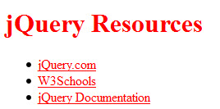
Attribute Selectors
$('[title]').css("color", "red");
<h1 title="resources">jQuery Resources</h1>
<ul>
<li><a href="http://www.jquery.com"
title="jQuery website">jQuery.com</a></li>
<li><a href="http://www.w3schools.com/jquery/jquery_ref_selectors.asp"
title="W3Schools jQuery reference">W3Schools</a></li>
<li><a href="http://docs.jquery.com"
title="jQuery documentation">jQuery Documentation</a></li>
</ul>

Slide 8
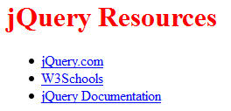
Attribute Selectors of a specific element
$('h1[title]').css("color", "red");
<h1 title="resources">jQuery Resources</h1>
<ul>
<li><a href="http://www.jquery.com"
title="jQuery website">jQuery.com</a></li>
<li><a
href="http://www.w3schools.com/jquery/jquery_ref_selectors.asp"
title="W3Schools jQuery reference">W3Schools</a></li>
<li><a href="http://docs.jquery.com"
title="jQuery documentation">jQuery Documentation</a></li>
</ul>

Slide 9
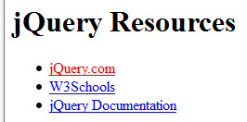
Attribute that has an exact value
$('[title="jQuery website"]').css("color", "red");
<h1 title="resources">jQuery Resources</h1>
<ul>
<li><a href="http://www.jquery.com"
title="jQuery website">jQuery.com</a></li>
<li><a
href="http://www.w3schools.com/jquery/jquery_ref_selectors.asp"
title="W3Schools jQuery reference">W3Schools</a></li>
<li><a href="http://docs.jquery.com"
title="jQuery documentation">jQuery Documentation</a></li>
</ul>
quotation marks

Slide 10

Selector / Filter – :first :last
Like CSS Shortcut
$(document).ready(function() {
$('li:first').css('background','#dedede');
$('li:last' ).css('background','#ff0');
}); //end ready
<ul>
<li>list item 1</li>
<li>list item 2</li>
<li>list item 3</li>
<li>list item 4</li>
</ul>

Slide 11

Selector / Filter – :even
Like CSS Shortcut
$(document).ready(function() {
$("li:even").css("color", "red");
}); //end ready
<ul>
<li>one</li>
<li>two</li>
<li>three</li>
<li>four</li>
<li>five</li>
</ul>
starts counting at 0

Slide 12

Selector / Filter – :nth-child(n)
Like CSS
$(document).ready(function() {
$("li:nth_child(3)").css("color", "red");
}); //end ready
<ul>
<li>one</li>
<li>two</li>
<li>three</li>
<li>four</li>
</ul>
starts counting at 1

Slide 13

Selector / Filter – :not(some_selector)
Like CSS
$(document).ready(function() {
$("li:not(:first)").css("color", "red");
}); //end ready
<ul>
<li>one</li>
<li>two</li>
<li>three</li>
<li>four</li>
</ul>

Slide 14
jQuery Methods
Methods can
set (write / change)
and
get (read / return)
properties/values

Slide 15
Useful jQuery methods
traversal methods
HTML attribute manipulation
CSS class manipulation
effect methods
built-in loop

Slide 16
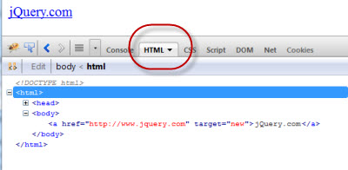
attr(name, value) Method
Like setAttribute()
Setting an attribute and value
$("a").attr("target" , "new");
<a href="http://www.jquery.com">jQuery.com</a>

Slide 17
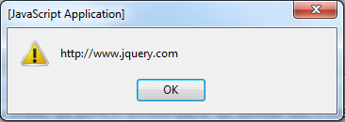
attr(name) Method
Getting a value for an HTML attribute
var theHref = $("a").attr("href"); alert(theHref);
<a href="http://www.jquery.com">jQuery.com</a>

Slide 18
addClass(class_name) Method
Like className property
Adding a CSS class
<style>
.colorRed {color: red}
</style>
$('h2').addClass('colorRed');
<h2></h2>

Slide 19
removeClass(class_name) Method
Removing a CSS class
<style>
.colorRed {color: red}
</style>
$('h2').removeClass('colorRed');
<h2></h2>

Slide 20
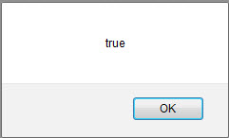
hasClass(class_name) Method
Testing to see if the class exists
<style>
.colorRed {color: red}
</style>
alert( $('h2').hasClass('colorRed') );
<h2 class="colorRed"></h2>

Slide 21
toggleClass(class_name) Method
Add and remove a class
$('#btn').click(function() {
$('h2').toggleClass('colorRed');
}); //end click
Effects all <h2> elements

Slide 22

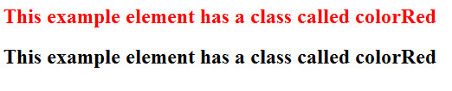
toggleClass(class_name) Method
Adds and removes the class
$('h2').click(function() {
$(this).toggleClass('colorRed');
}); //end click
Effects current <h2> element

Slide 23

next() Traversal Method
Like nextElementSibling
Get the next sibling
$('li.third').next().addClass('colorRed');
<ul>
<li>list item 1</li>
<li>list item 2</li>
<li class="third">list item 3</li>
<li>list item 4</li>
</ul>

Slide 24

prev() Traversal Method
Get the sibling immediately before
$('li.third').prev().addClass('colorRed');
<ul>
<li>list item 1</li>
<li>list item 2</li>
<li class="third">list item 3</li>
<li>list item 4</li>
</ul>

Slide 25
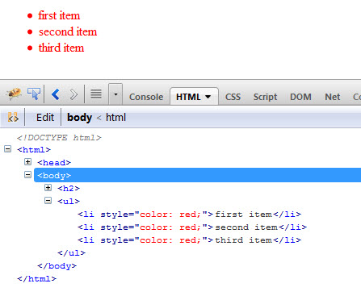
each(function) Method – takes a function
$("li").each(function() {
$(this).css("color" , "red");
}); // end each
Refers to each instance of the selector

Slide 26
hide() Method
Hides the selector (display: none)
$('#btn1').click(function() {
$('#para1').hide();
}); // end click
<input type="button"
id="btn1"
value="Click Me">

Slide 27
show() Method
Shows the selector (display: block)
$('#btn2').click(function() {
$('#para1').show();
}); // end click
<input type="button"
id="btn2"
value="Click Me">

Slide 28
Useful jQuery event methods
Compound event / 2 functions
Compound event / 2 functions
Deprecated version 1.7

Slide 29
click() Event Method – code will run for each click
$(document).ready(function() { $('#btn').click(function() { // code to be executed here }); // end click }); // end ready

Slide 30
hover() Event Method – takes 2 functions for mouseover / mouseout
$('h2').hover(
function() {
$(this).addClass('effect');
} , // end mouseover
function() {
$(this).removeClass('effect');
} // end mouseout
); // end hover

Slide 31
toggle() Event Method - DEPRECATED – takes 2 functions for 1st click / 2nd click
$('#para1').toggle(
function() {
$(this).css('color', 'red');
} , // first click
function() {
$(this).css('color', 'black');
} // second click
); // end toggle

Slide 32
Other Event Methods

Slide 33
bind() event method – replaced by on() – deprecated version 3
$('#btn').bind('click', function() {
$('#para1').css('color', 'red');
});
$('#btn’).on('click', function() {
$('#para1').css('color', 'red');
});
$('#btn').click(function() {
$('#para1').css('color', 'red');
});
bind()
on()
traditional

Slide 34
on() event method - 2 events / 2 handlers
Advantage: can attach multiple events / handlers
$('#para1’).on( {
'click' : function() {
$(this).css('color', 'red');
} ,
'mouseover' : function() {
$(this).css('background-color','yellow');
}
}); // end on
First event
comma
Second event

Slide 35
on() Event Method – using named function
function changeRed() { $(this).css('color', 'red’); }
$('#para1’).on('click doubleclick', changeRed);
$('#para1’).click(changeRed);
$('#para1’).doubleclick(changeRed);

Slide 36
off() Event Method – using named function
function changeRed() { $(this).css('color', 'red’); }
$('#para1’).on('click', changeRed);
$('#para1’).off('click');

Slide 37
one() Event Method – code will run once
$(document).ready(function() { $('#btn').one('click', function() { // code to be executed here }); // end one }); // end ready

Slide 38
DOM Manipulation Methods – not in text
Write to the page
append() method
This method will add the new content to the end of the existing content.
prepend() method
This method will add the new content to the beginning of the existing content.
Note: html() replaces existing content!

Slide 39

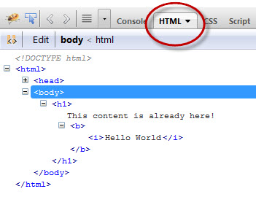
append() Method – at the end
$("h1").append(“ <b><i>Hello World</i></b>");
<h1>This content is already here!</h1>
appended

Slide 40

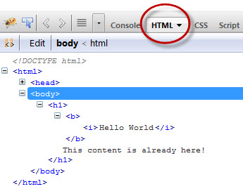
prepend() Method – at the beginning
$("h1").prepend("<b><i>Hello World</i></b> ");
<h1>This content is already here!</h1>
prepended

Slide 41
DOM Manipulation Methods – not in text
appendTo() method
This method takes a selector as a parameter and uses that selector to place the content.
prependTo() method
This method takes a selector as a parameter and uses that selector to place the content.

Slide 42
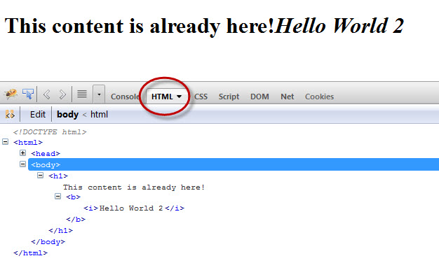
appendTo() Method
Requires a selector
$("<b><i>Hello World 2</i></b>").appendTo("h1");
<h1>This content is already here!</h1>
appended to <h1>

Slide 43
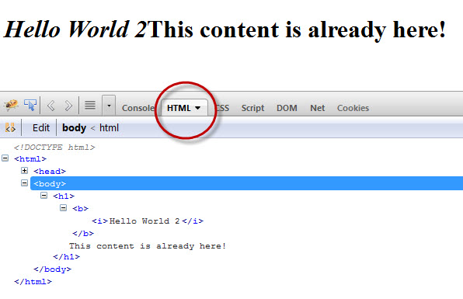
prependTo() Method
Requires a selector
$("<b><i>Hello World 2</i></b>").prependTo("h1");
<h1>This content is already here!</h1>
prepended to <h1>

Slide 44
DOM Manipulation Methods – not in text
before() method
This method will add the new content before the selection
after() method
This method will add the new content after the selection

Slide 45

before() Method – before the selector
$("h1").before("<p><i>Hello World</i></p>");
<h1>This content is already here!</h1>

Slide 46

after() Method – before the selector
$("h1").after("<p><i>Hello World</i></p>");
<h1>This content is already here!</h1>

Slide 47
DOM Manipulation Methods – not in text
insertBefore() method
This method takes a selector as a parameter and uses that selector to place the content.
insertAfter() method
This method takes a selector as a parameter and uses that selector to place the content.

Slide 48
insertBefore() Method
Requires a selector
$("<p><i>Hello World</i></p>").insertBefore("h1");
<h1>This content is already here!</h1>

Slide 49
insertAfter() Method
Requires a selector
$("<p><i>Hello World</i></p>").insertAfter("h1");
<h1>This content is already here!</h1>

Slide 50
DOM Manipulation Methods – not in text
remove() method – similar to delete
This method will remove the selected element.
detach() method – similar to cut / paste
This method will remove but keep a copy of the selected element. You must then do something with it.
clone() method – similar to copy / paste
This method will clone or copy the selection. You must then do something with it.

